Slide 1


Seizure Prediction Team 1 By: Rashmi, Matthew, Shruti 31 October, 2016
https://github.com/matthewbrawley/SeizurePredictionTeam1
https://trello.com/b/aYWosa6e/seizure-prediction-sprint-2
Notes:
1

Slide 2
Project Goal
Develop a system to predict epileptic seizures using EEG recordings; treating the recordings as real time EEG data of an epileptic patient.
Develop an app to provide notification to the patient and an emergency contact during the seizure stages
2

Slide 3
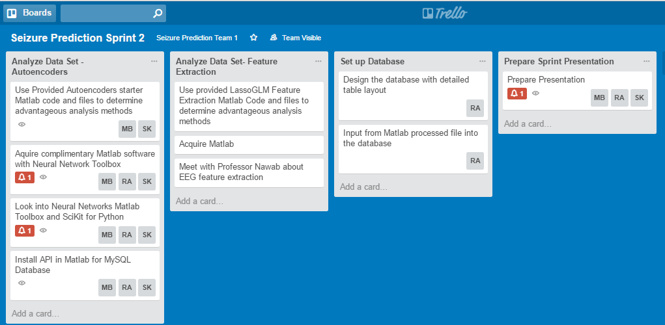
Trello Sprint 2 Diagram

Slide 4
Trello Sprint 2 Diagram
*
Signal Processing
Study of methods of Signal Processing (in MATLAB), generate preliminary results
Auto-encoders
Feature Extraction
Try the sample solutions in Python (Open Source)
Database
Creation of the database with preliminary results
4
Notes:
Intro to Auto encoders and Feature extraction
Python: Open source + MATLAB Licence
Database: Using Database server as MySQL ; created the database model, setup.

Slide 5
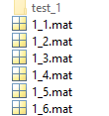
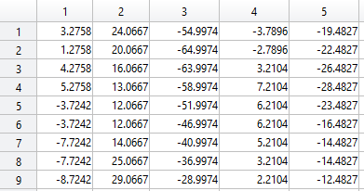
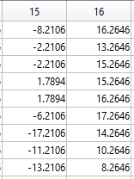
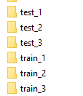



Data Set
Files
16 Channel EEG data
..........
..........
..........
..........
..........
5
[1]

Slide 6
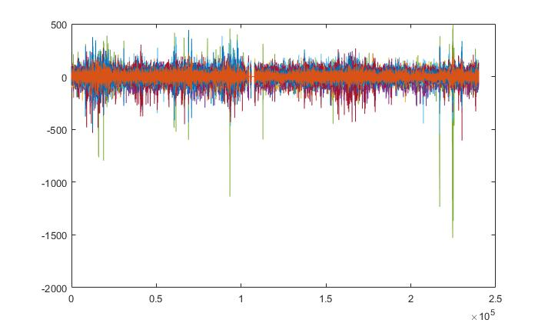
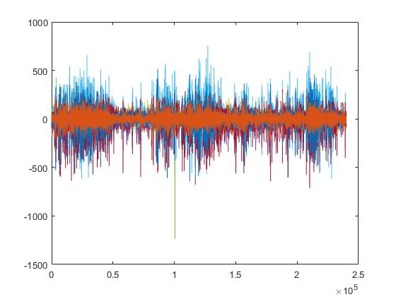
Data Set
16 Channel EEG data
TRAINING DATA
Inter-ictal
Pre-ictal
TESTING DATA
Need to process & identify
6

Slide 7
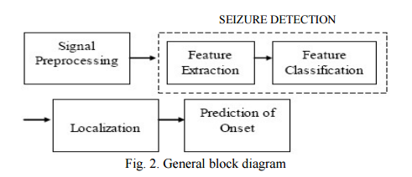
System Diagram
(Level 1: From Sprint 1)
Processing Unit
EEG Data
[1]
Database
App
Emergency Contact
[1]
Patient
Kavya Devarajan, E. Jyostna, K. Jayasri, and Vinitha Balasampath EEG-Based Epilepsy Detection and Prediction, IACSIT International Journal of Engineering and Technology, Vol. 6, No. 3, June 2014
7

Slide 8
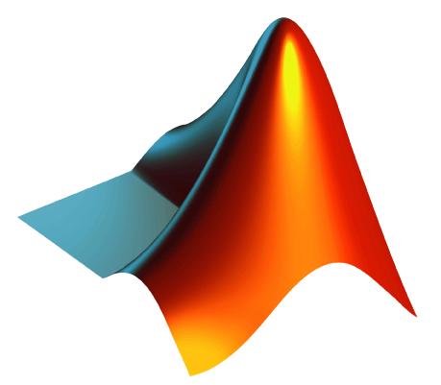
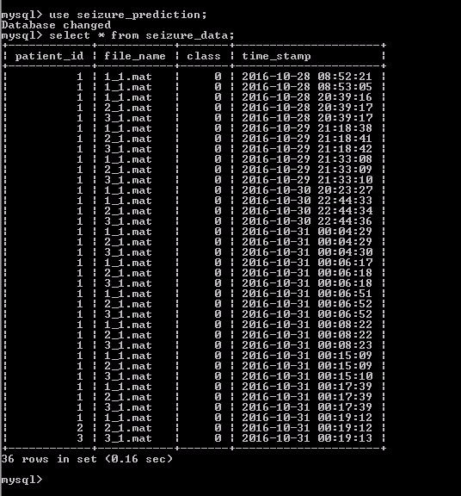
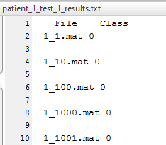
System Diagram A
(Level 2)
EEG Data
Processing Unit
MATLAB Auto-encoder code
Trained Deepnet
Can now take ‘Test’ files and identify similar features as ‘Train’ files
Database
App
Seizure Class
8

Slide 9

System Diagram B
(Level 2)
EEG Data
Processing Unit
MATLAB Feature Extraction code
Python Feature Extraction code
Database
App
Seizure Class
9

Slide 10
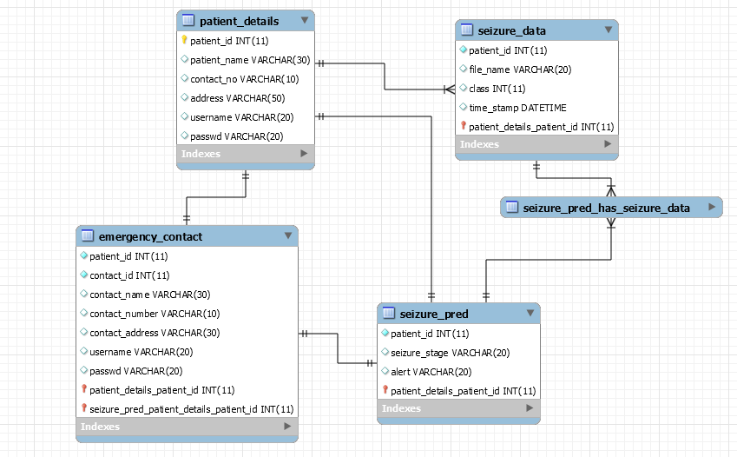
Database Model
Notes:
Security : Password protected database

Slide 11
Database Model

Slide 12
Accomplishments
*
Ran neural network and generated trained deepnet
Tested files on trained deepnet and generated seizure predictions
Researched feature extraction of EEG signals and neural networks
Got access to the Shared Computing Cluster (SCC) and uploaded the EEG data to the shared cluster for multicore parallel computing feature extraction method
Established MATLAB to MySQL Database Connection and stored sample data from MATLAB to database tables.
12

Slide 13
Challenges
*
EEG Feature extraction is very complex
Attempting to understand & extract 8 different signal characteristics
Data drop out/ artefacts increases the difficulty of the challenge
Preliminary results from the auto-encoder code is generating no-seizure output for test files
Filtering the noise from EEG signals
Processing power required is immense
Executing multicore MATLAB parallel computing toolbox batch jobs on SCC
13
Notes:
EEG affected by literally any brain activity- voluntary and involuntary.
EEG- Noise filtering part- How to go about it

Slide 14
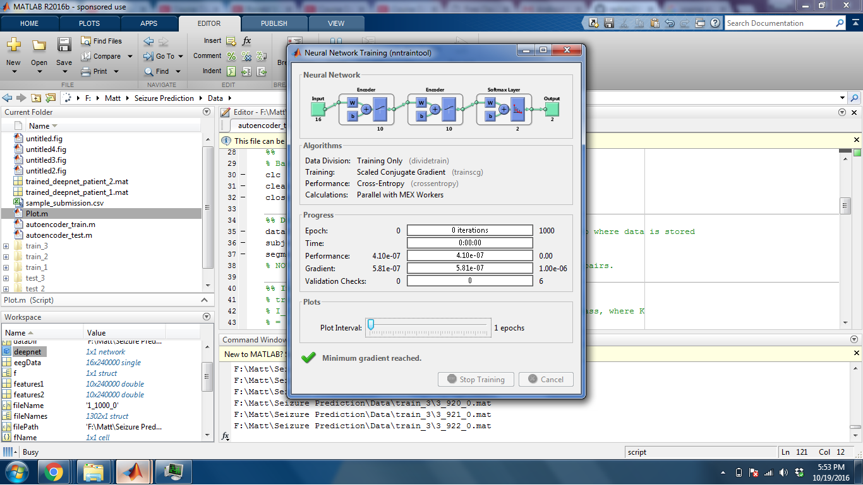
DEMO
*
14

Slide 15
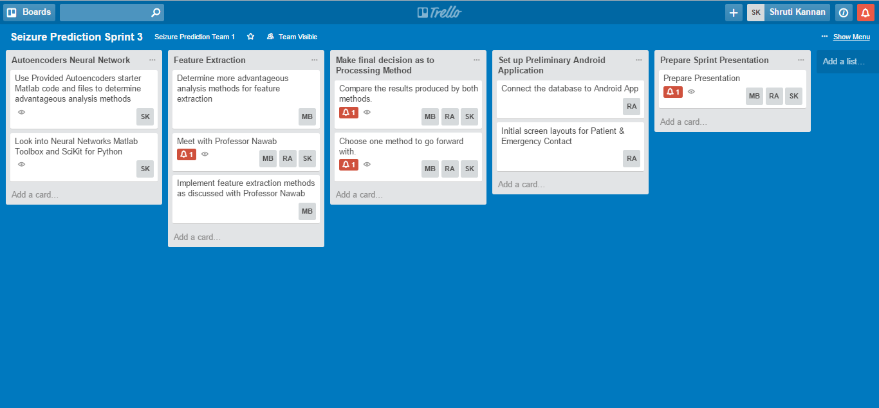
Next Sprint Plan
*
15

Slide 16
THANK YOU! QUESTIONS?
*
16

